Slide 1
IT11L COMPUTER NETWORK LESSON 1

Slide 2
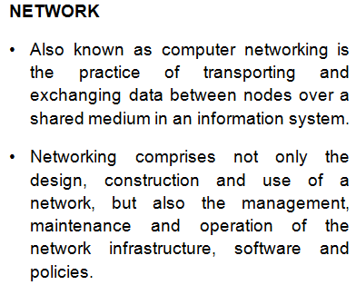
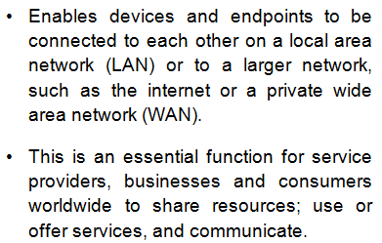
COMPUTER NETWORK REVIEW

Slide 3



COMPUTER NETWORK REVIEW

Slide 4




COMPUTER NETWORK REVIEW
NIC – Network Interface Card

Slide 5
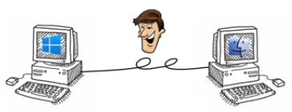
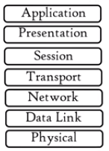


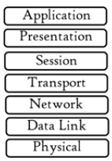
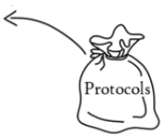


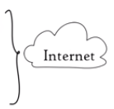

COMPUTER NETWORK REVIEW

Slide 6
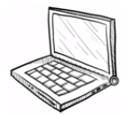




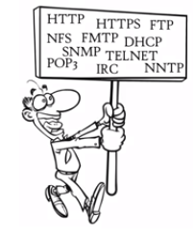



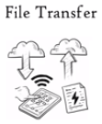


COMPUTER NETWORK REVIEW

Slide 7

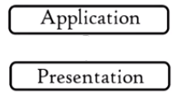


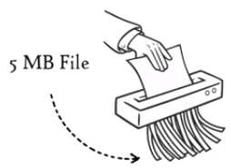



COMPUTER NETWORK REVIEW

Slide 8



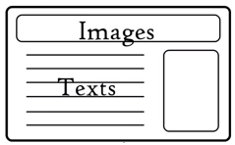
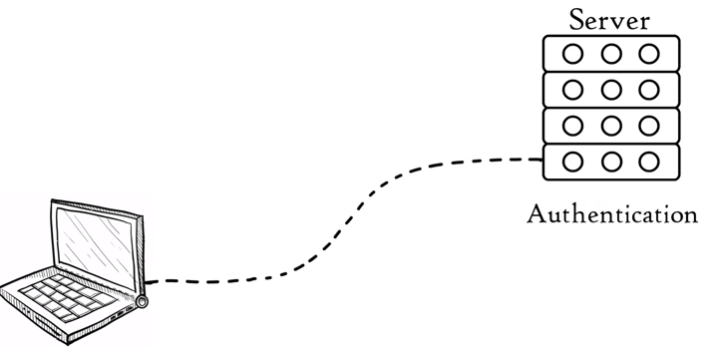






COMPUTER NETWORK REVIEW
Notes:
APIs – Application Programming Interfaces
NETBIOS – Network Basic Input/Ouput

Slide 9













COMPUTER NETWORK REVIEW

Slide 10



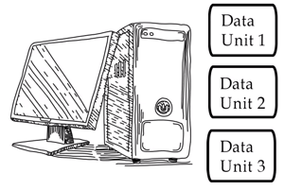










COMPUTER NETWORK REVIEW

Slide 11










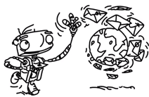

COMPUTER NETWORK REVIEW

Slide 12
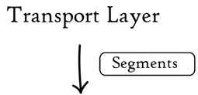
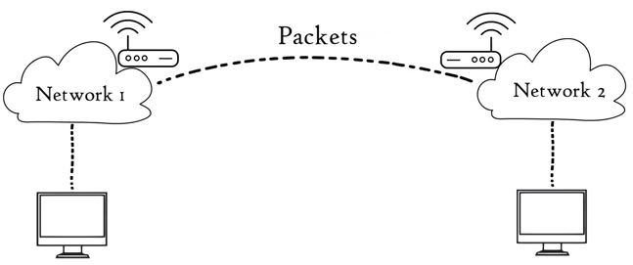





COMPUTER NETWORK REVIEW

Slide 13

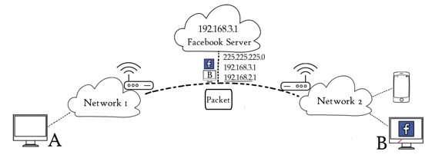
COMPUTER NETWORK REVIEW

Slide 14


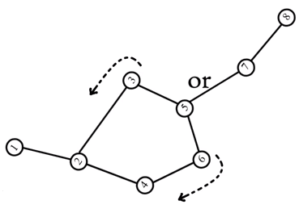


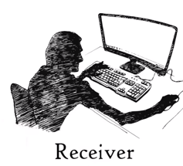
COMPUTER NETWORK REVIEW

Slide 15
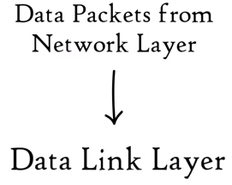





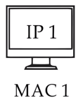
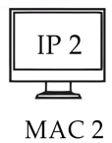





COMPUTER NETWORK REVIEW

Slide 16

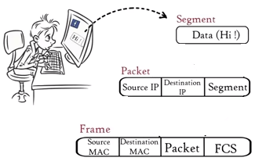
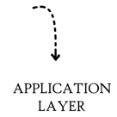








COMPUTER NETWORK REVIEW

